Slide 1
3D-Printing For Beginners

Slide 2
Workshop overview
Introduction and Expectations
Goal of the Workshops
Basics of 3D Printing
Introduction to Tinkercad
3D Modeling
Introduction to Ultimaker Cura
Print Preparations
Results and Feedback

Slide 3
Goals of the workshop
Understanding of the process of 3D printing
Understanding of opportunities and limitations
Basic 3D modeling using „Tinkercad“
Slicing and refining using „Cura“
Printing using Ultimaker S5

Slide 4
What is 3D printing?
3D printing, also known as additive manufacturing, is a process of creating physical objects from a digital 3D model.
It involves building up layers of material, such as plastic, metal, or resin, until the desired shape or structure is formed.
3D printing can be used in a variety of industries, from product design and prototyping to aerospace and healthcare, and has the potential to revolutionize the way we manufacture and produce goods.

Slide 5
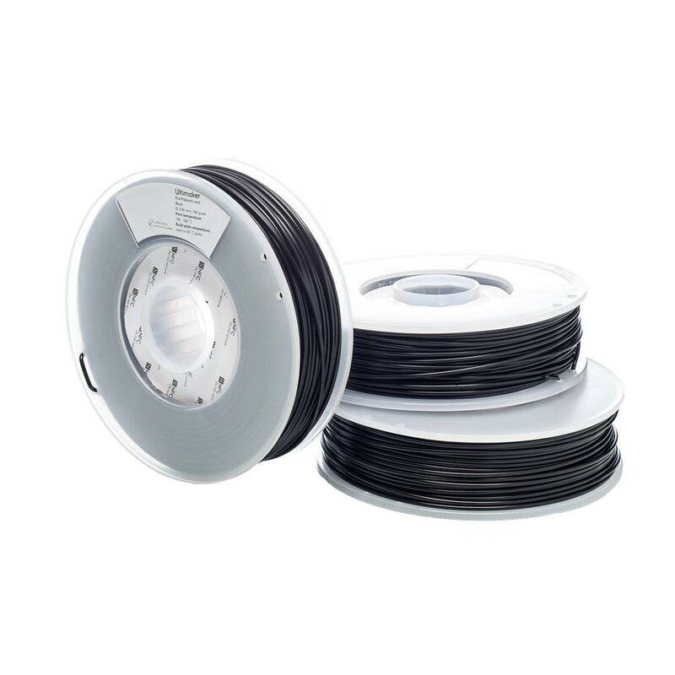
Possible materials for 3D printing
Plastic
  PLA(Polylactic acid)
  ABS(Acrylonitrile butadiene styrene)
  PETG(Polyethylene terephthalate)
Resin
Ceramic
Metal
Edibles(chocolate etc.)

Slide 6
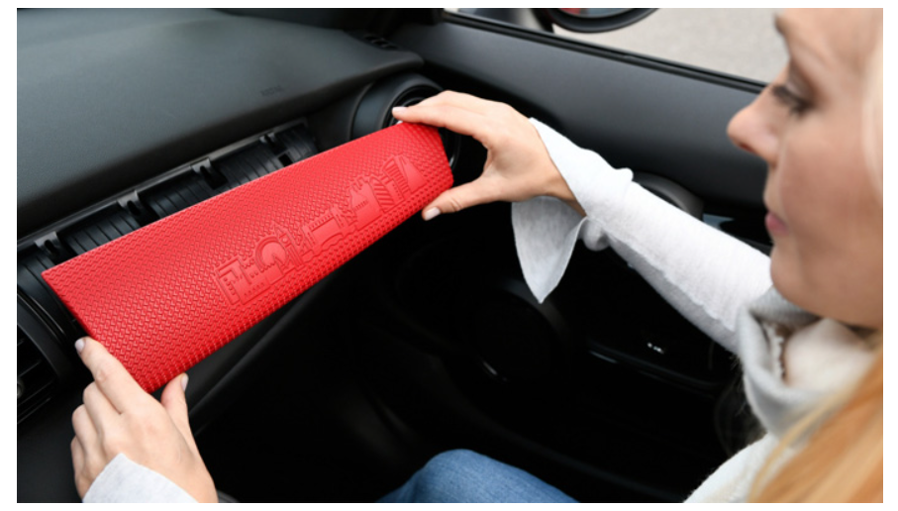
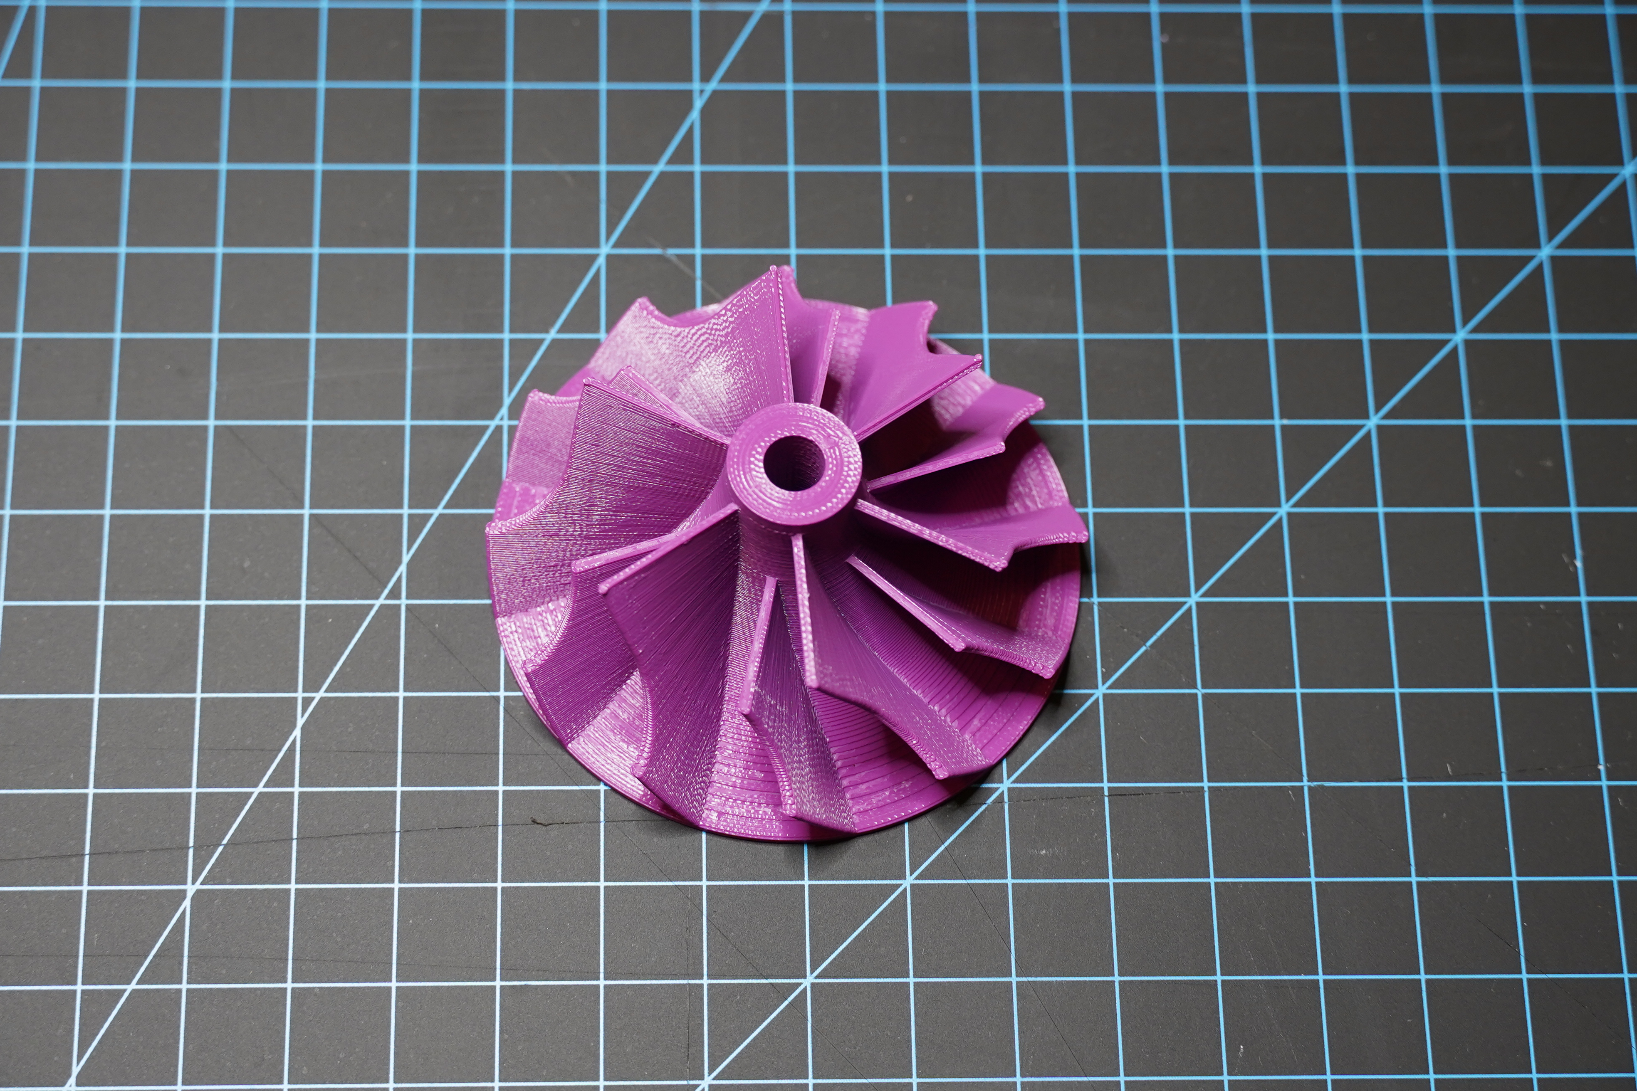
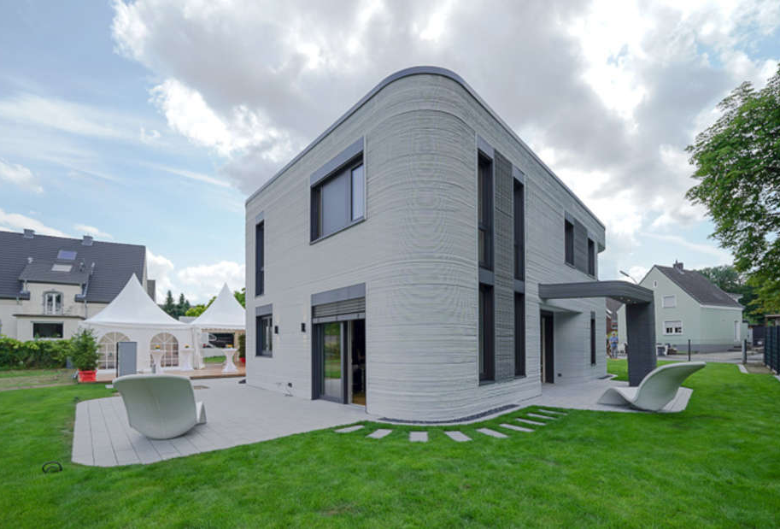
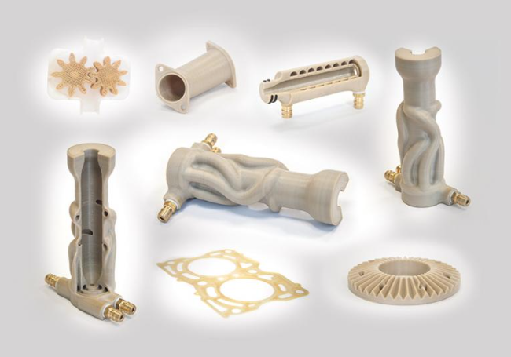
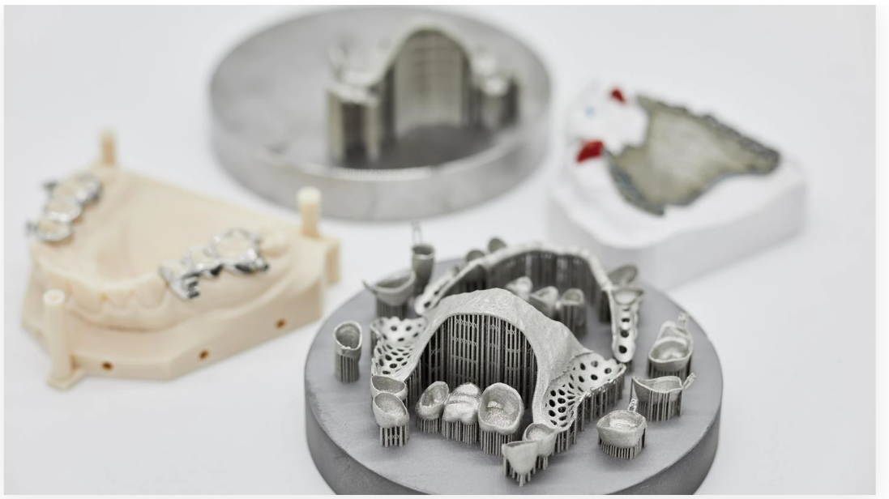
Use cases of 3D printing
Rapid prototyping
Automotive industry
Aerospace industry
Medicine & Healthcare
Rehabilitation & Accessibility
3dnatives.com, 25.01.2023
chemanager-online.com, 25.01.2023
wa.de, 25.01.2023
www.trumpf.com, 25.01.2023

Slide 7
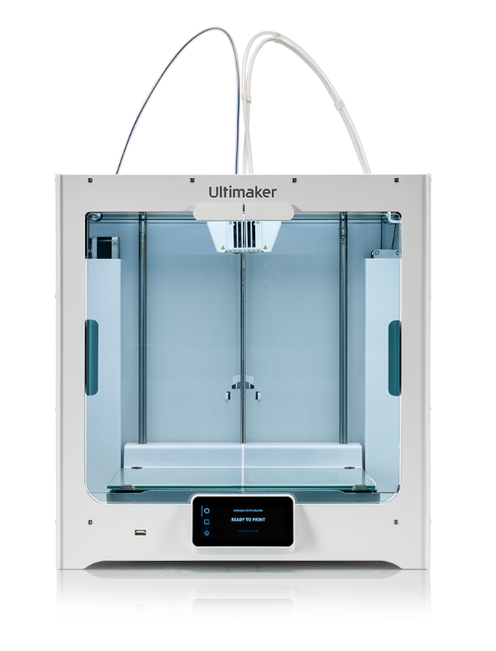
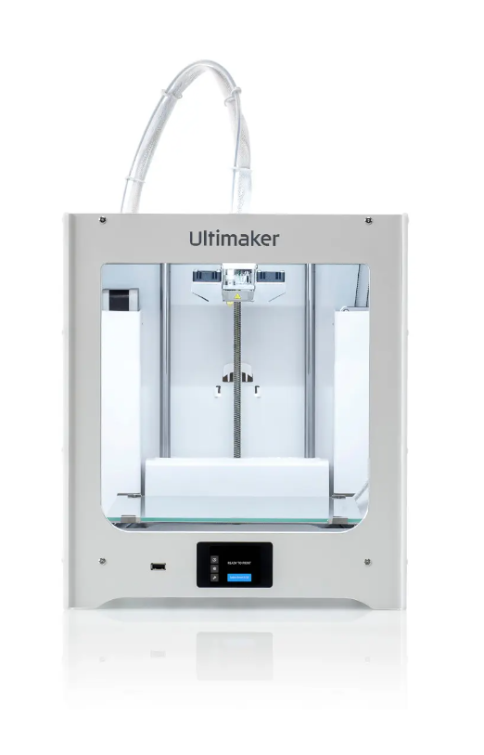
3D printers in Hylec
Ultimaker S5
Ultimaker 2+ connect

Slide 8
Different 3D printing processes
FDM (Fused deposition modelling)
DED (Directed energy deposition)
SLS (Selective laser sintering)
SLA (Stereolithography)

Slide 9
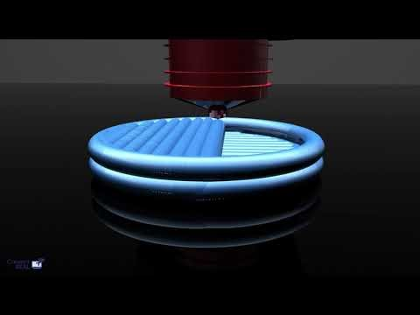
FDM 3D Printing Animation
https://www.youtube.com/watch?v=TZmYTfPfhNE

Slide 10
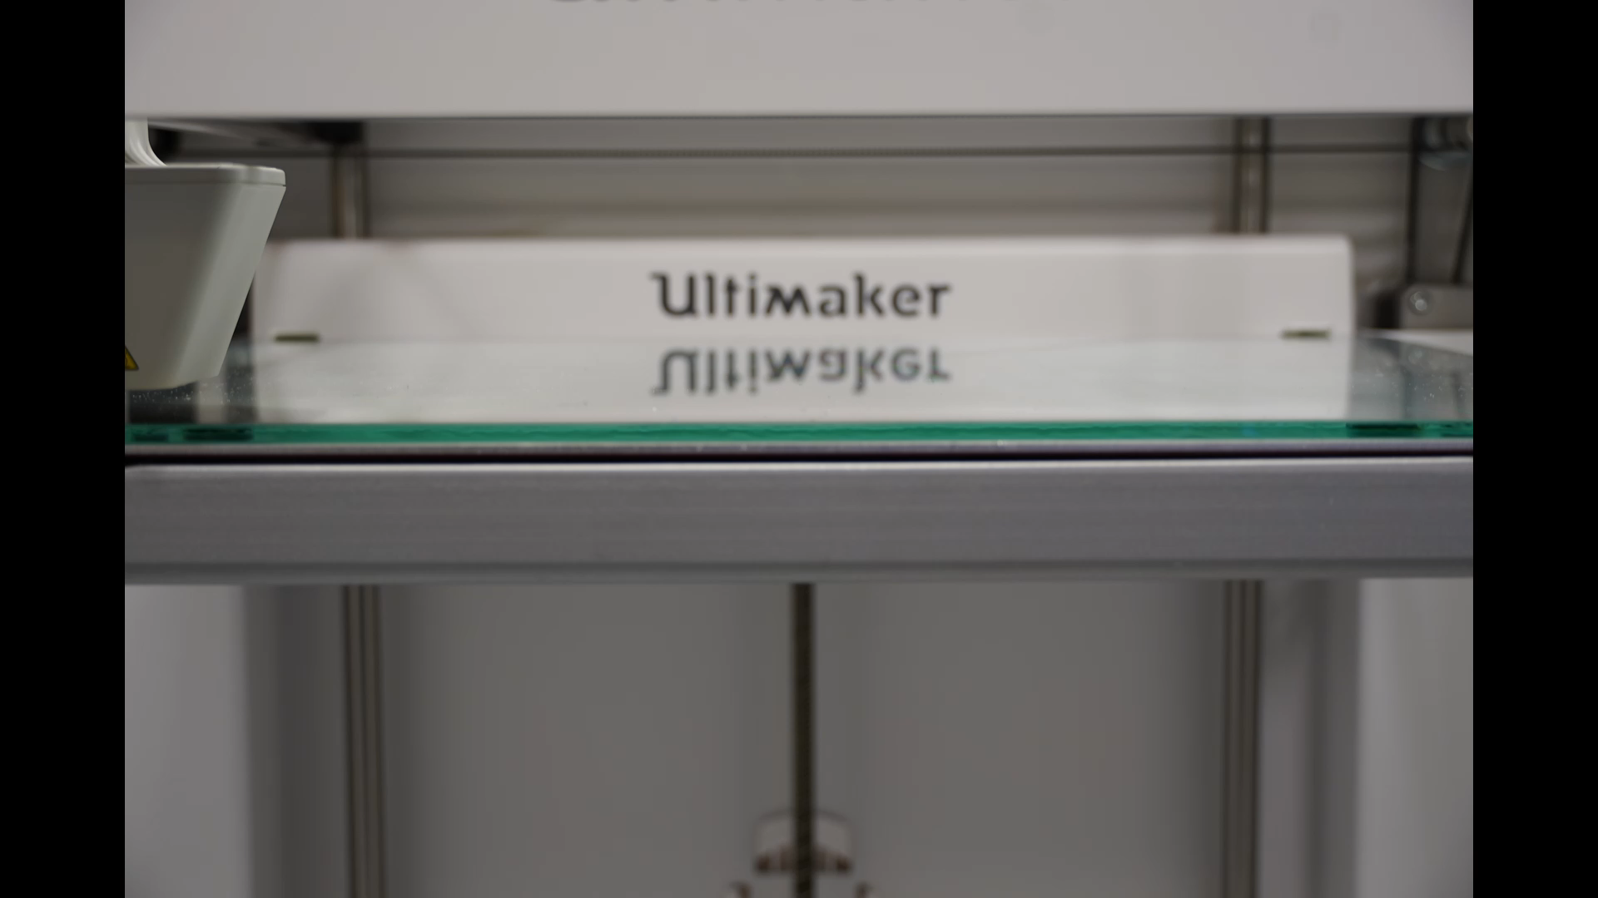
Video Demo FDM-Printer

Slide 11
3D printing process
Model
Finding a Model that is „Printable“
Editing or Modelling a printable Model(Tinkercad)
Exporting as Mesh
Slice
Slicing and tweaking using a slicer(Ultimaker Cura)
Print
Sending G-code to the printer and printing

Slide 12
Introduction to Tinkercad
Free CAD-software (computer-aided design)
Beginner friendly
Based on primitive shapes

Slide 13
Tinkercad Demo
Join the course via following link:
https://www.tinkercad.com/joinclass/PYLJP2DHX
Or using following code:
PYLJP2DHX

Slide 14
Modelling a keychain
Notes:
What is the functional requirements?
What is the structural requirements?
How should the dimentions be defined?

Slide 15
Reviewing the models
Notes:
Is it printable?
Does it need supports?
Does it need refinement/rework after the printing?
How is the structural integrity?

Slide 16
Introduction to Ultimaker Cura
Free open source slicer-software
Slices the model into different layers
Generates infill and support structure
Generates G-code for printer

Slide 17
Example Model – Cuddling Owls
Draft 0.3mm 10% Infill ~4 Hrs.
Engineering 0.15mm 10% Infill ~13 Hrs.
Visual 0.1mm 10% Infill ~16 Hrs.
Default 0.06mm 10% Infill ~23,5 Hrs.

Slide 18
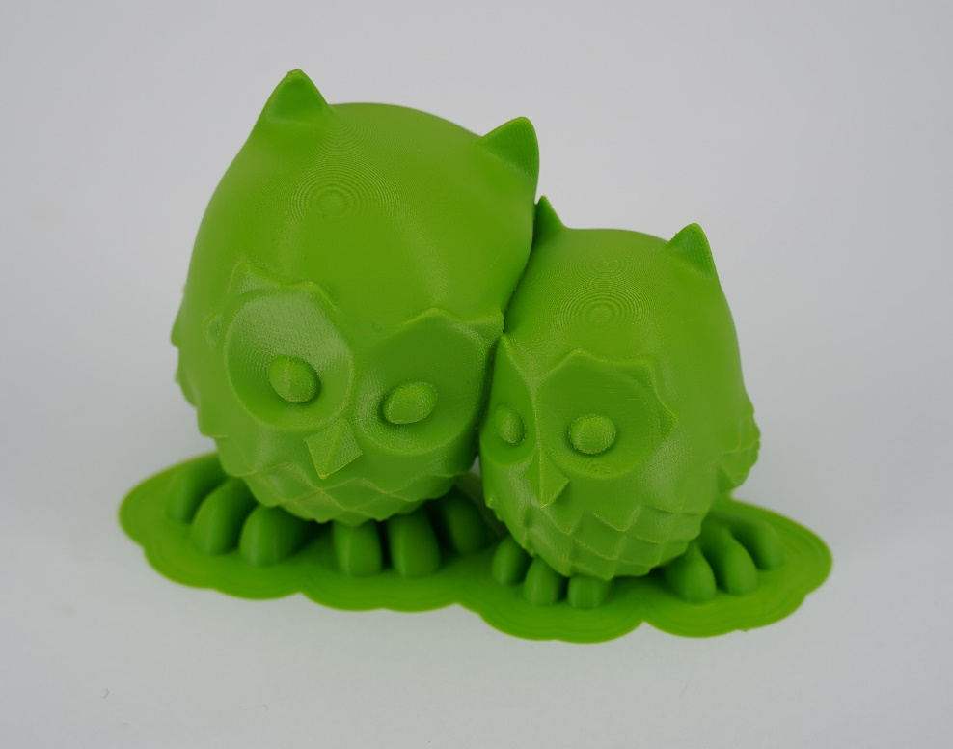
Example Model – Cuddling Owls

Slide 19
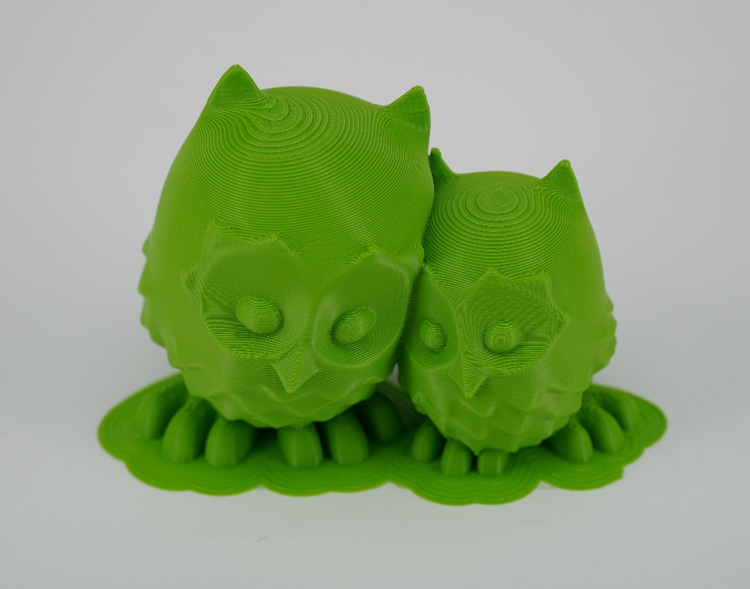
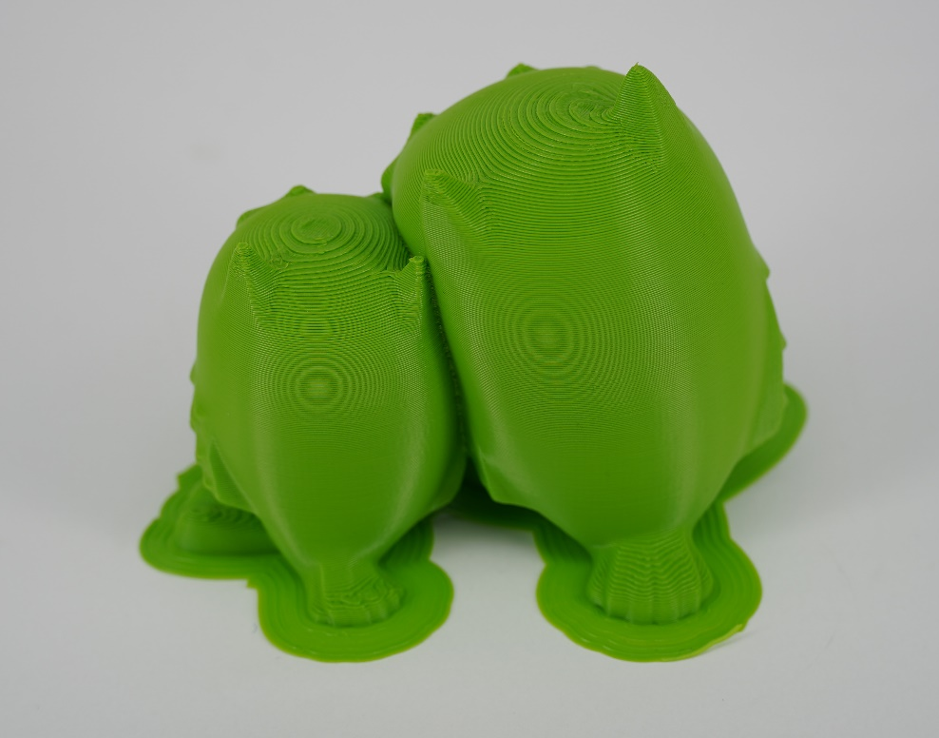
Draft 0.3mm | 10% infill | Adhesion | ~ 4 Hrs

Slide 20
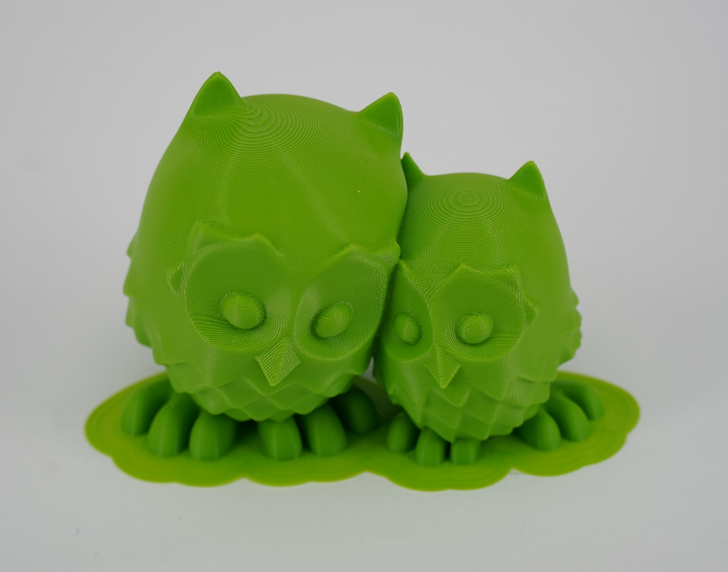
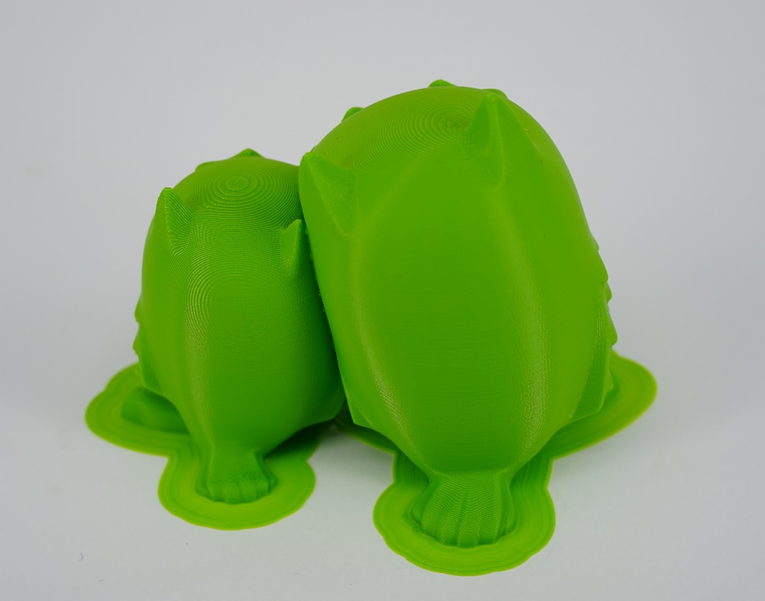
Engineering 0.15mm | 10% infill | Adhesion ~ 13 Hrs

Slide 21
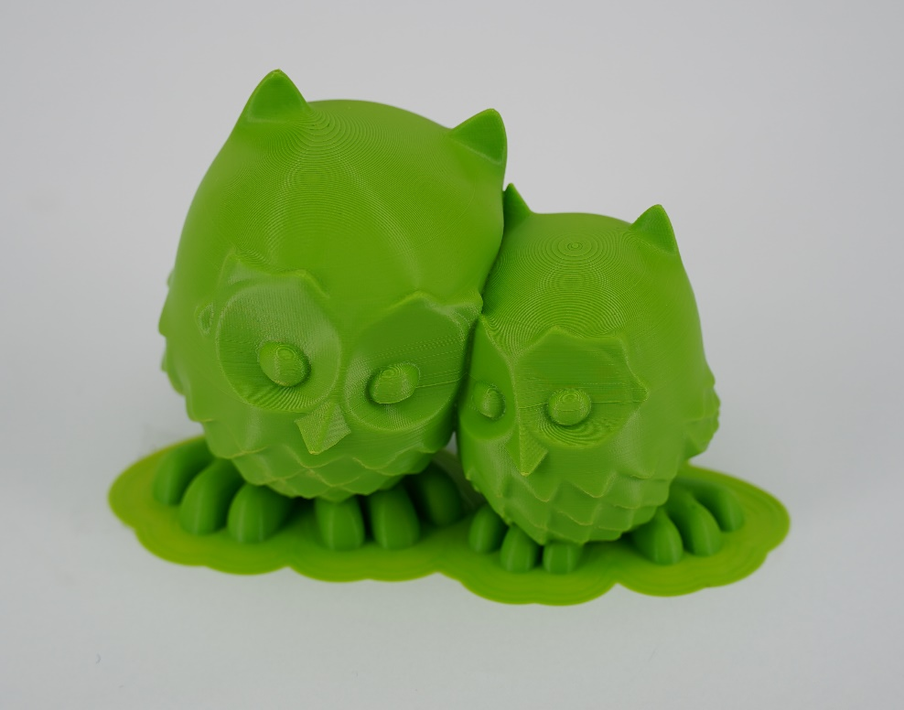
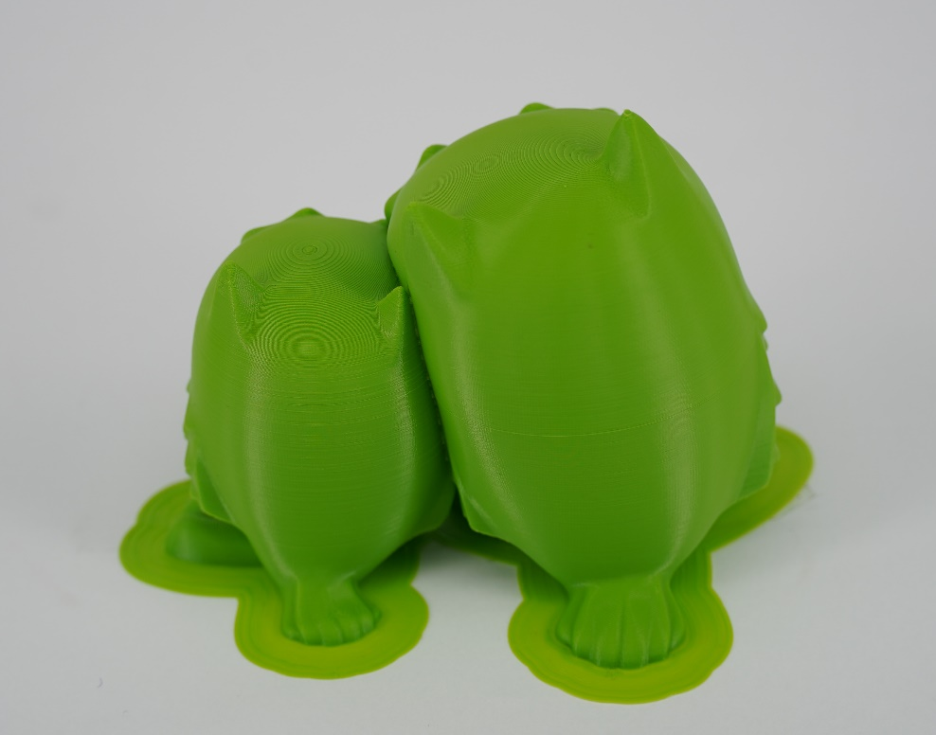
Visual 0.1mm | 10% infill| Adhesion ~ 16 Hrs

Slide 22
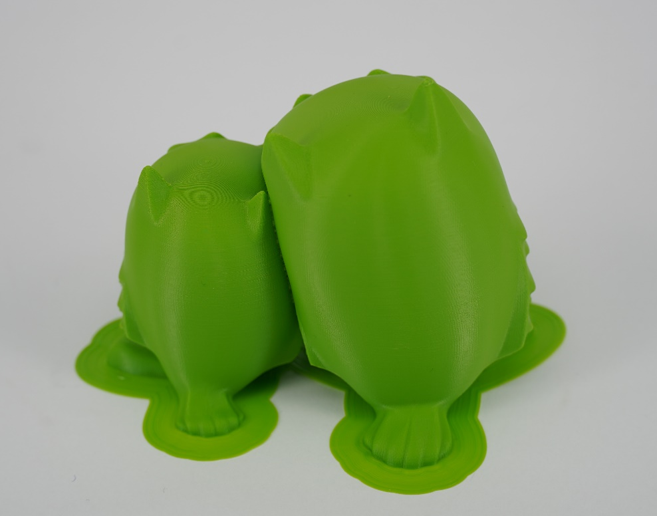
Default 0.06 | 10% infill | Adhesion ~ 23,5 Hrs

Slide 23





Slide 24





Slide 25
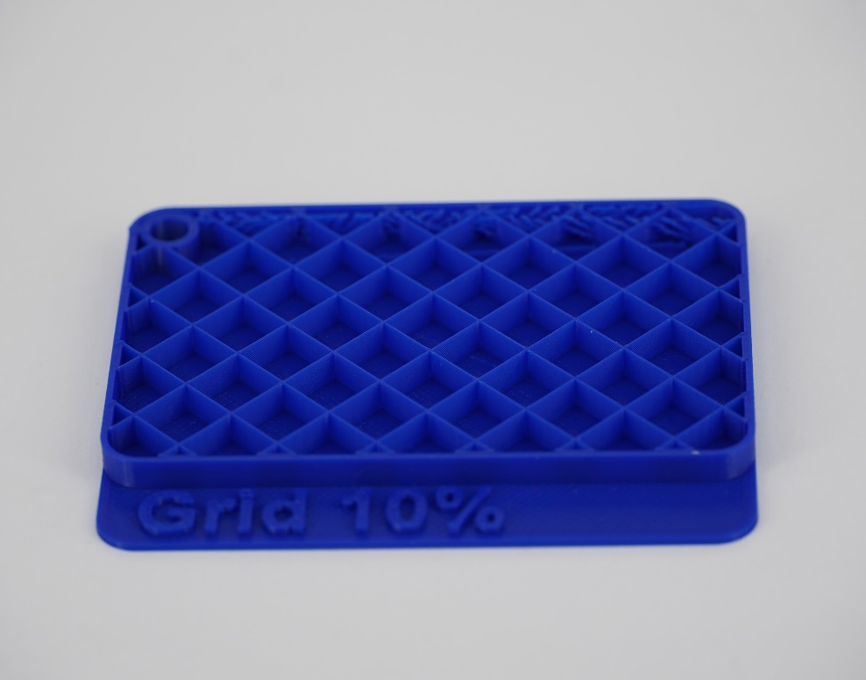
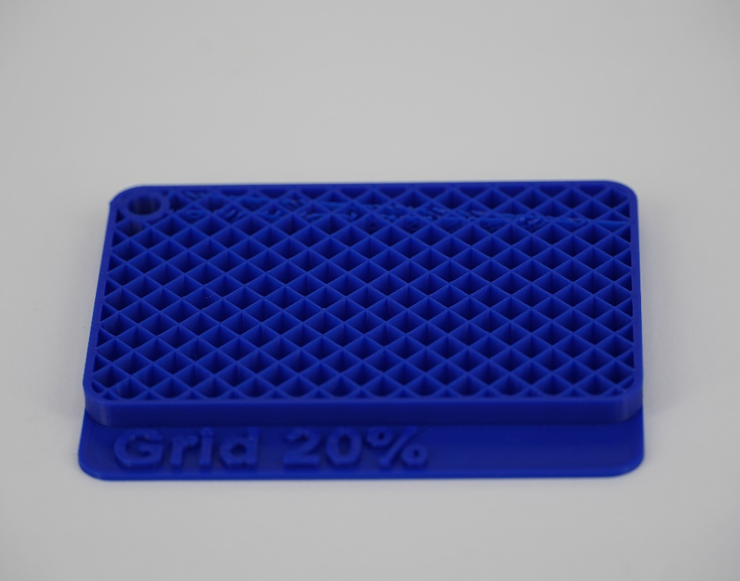
Infill Grid

Slide 26
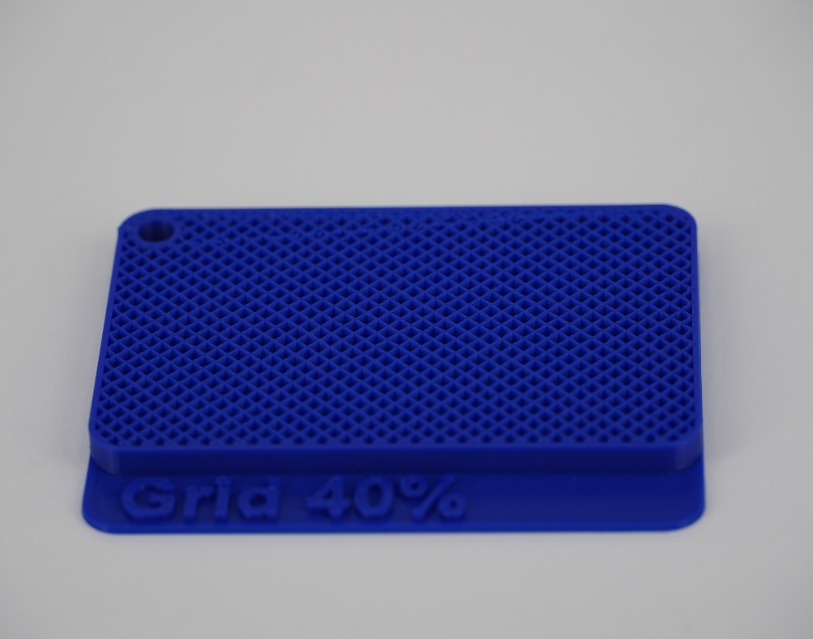
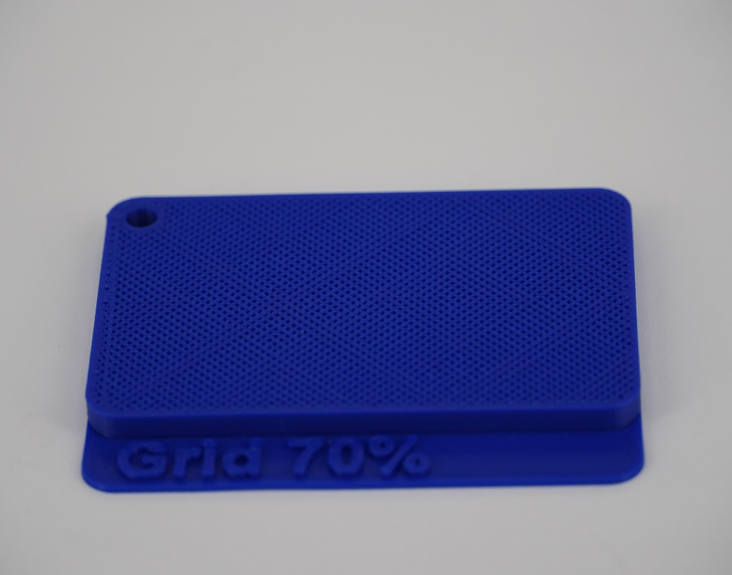
Infill Grid

Slide 27
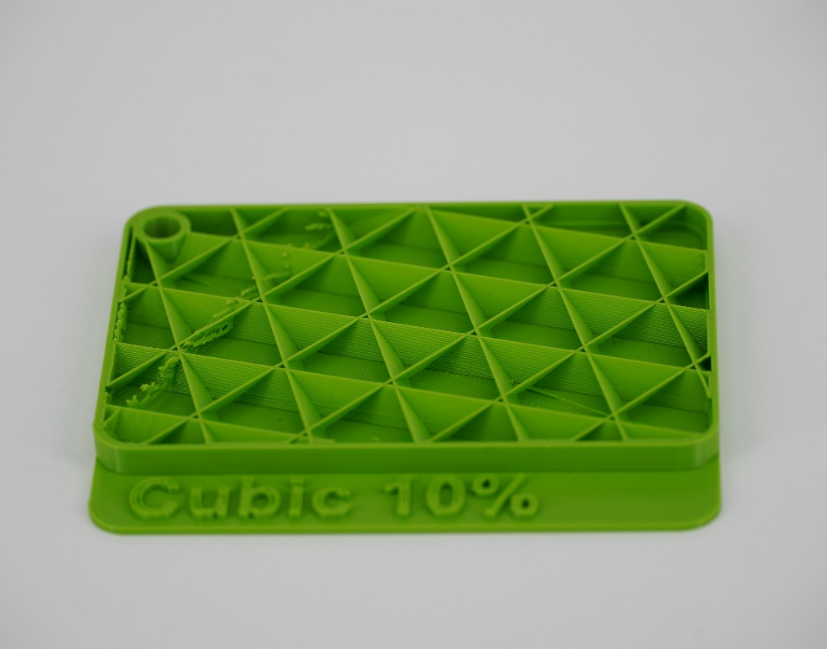
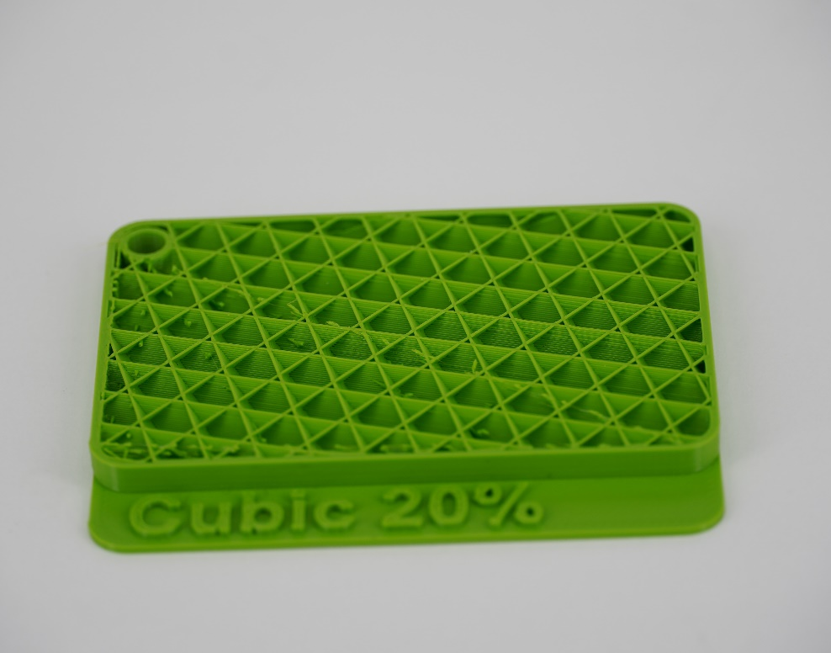
Infill Cubic

Slide 28
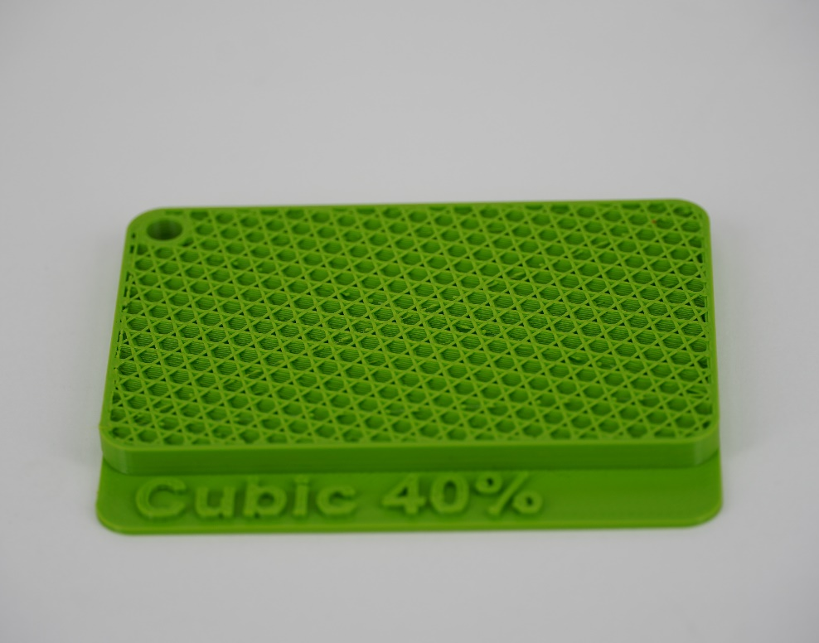
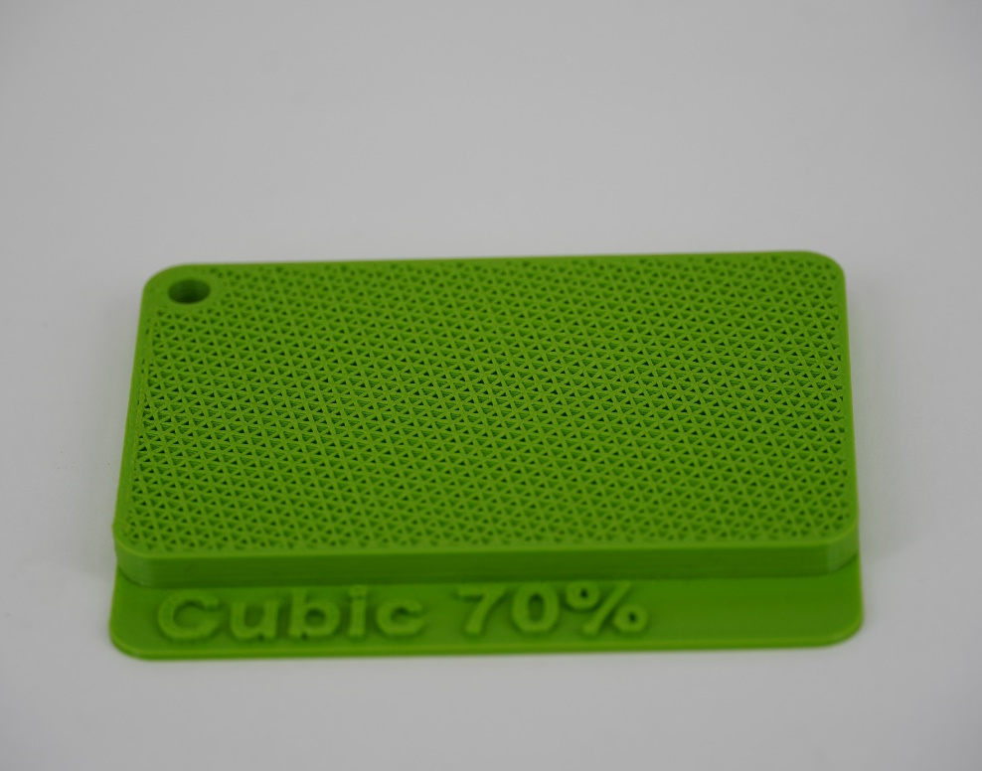
Infill Cubic

Slide 29
Print preparations in Cura
Lets slice and print!

Slide 30
Recommendations
Printables.com
Thingiverse.com
Autodesk Fusion 360

Slide 31
Conclusion and Feedback

