Slide 1
Inclusive ELT in a digital world
These projects are the culmination of a course conducted during the winter semester 2023/2024 at the TU Dortmund University. Students studying for all school forms spent the semester exploring different kinds of dis/abilities and difference, as well as their implications for the English language learning classroom.
The course was taught by Carolyn Blume.
Students used the resources of the HyLeC: Hybrid Learning Center to design and create products for use in inclusive and heterogeneous English classrooms in all school forms. They used 3D printers, laser cutters, sewing machines, embroidery, and various materials to create haptic teaching and learning materials for their future classroom practice.

Slide 2
Interactive lesson dice
Main idea: The dice can be rolled to determine the social form for each task (group work, partner work and solo work).

Slide 3
“Dear Teacher”
This is helping students communicating their needs during class without interrupting it. It gives more information than raising one's hand.

Slide 4
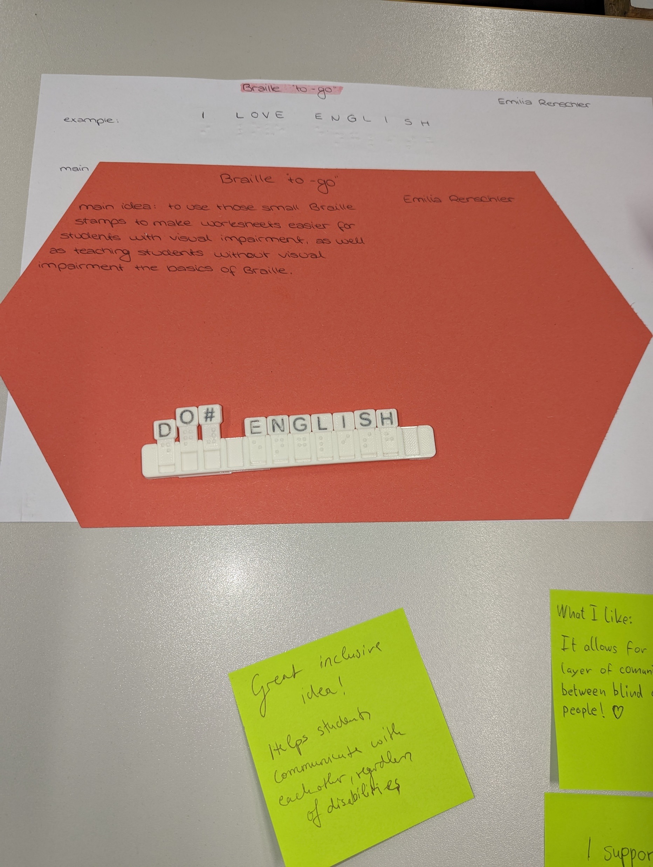
Braille “to-go”
A portable tray holds letters that are in Braille and in Latin letters.

Slide 5
Class council realia
Three dimensional objects that can be used to structure communication.

Slide 6
Coin comprehension box
A lightwood box with three slots for inserting a “coin” with an individual’s name on it. Inside the box are 3 chambers, keeping the coins separated from one another.

Slide 7
An informative sign
The sign comes with arrows engraved with each pupil’s name. Students can set them on their desks and put the arrow on the statement that applies to them.
Created with laser cutter by Thea Nolte
Thea Nolte

Slide 8
Emotion Dice
A soft cube with Velcro to attach various laminated images.

Slide 9
Preposition pairs
Accessible and inclusive revision exercise/game for preposition of place (Grade 5). The cards contain images, Braille, and QR codes that lead to audio files.

Slide 10
Preposition Pairs
A close up of one of the wooden tiles. All of the tiles fit in the wooden box in the background.

Slide 11
Pencil fidget spinner
Stimulation to help children focus and keep their pencils close.

Slide 12
Emotion buttons
Pupils can place a disc on their desk to show how they are feeling.

Slide 13
ReadingRuler
Helps students with difficulties in reading. Especially for students with dyslexia and ADHD so that they can put their focus on one line and don’t get distracted.

Slide 14
3D Wimmelbild
Students can depict scenes and tell stories with props.

